Slide 1
Trillium Trail preliminary physiology results
Pre-canopy closure

Slide 2
Brief collection strategy
Tagged Trillium and Maianthemum individuals from Jessie’s demography data (plots 3, 5, 7)
Dynamic CO₂ response curves and fluorescence measurements
Snapshot physiology measurements using first point of each response curve

Slide 3
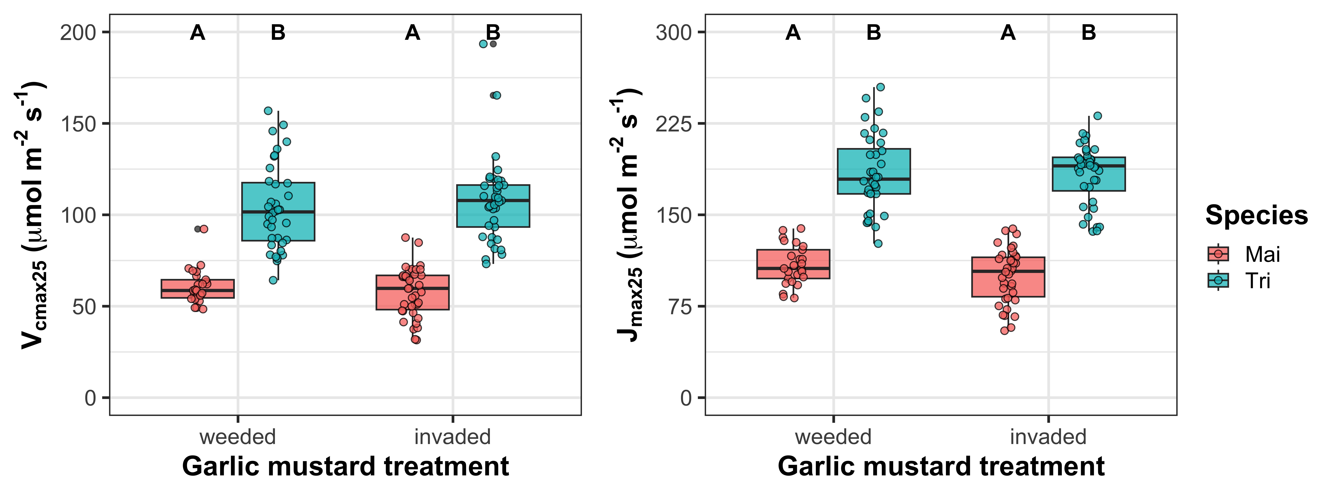
GM presence does not modify leaf biochemical process rates in Trillium or Maianthemum
R²_{m}=0.62; R²_{c}=0.77
R²_{m}=0.69; R²_{c}=0.80

Slide 4
GM presence does not modify leaf biochemical process rates in Trillium or Maianthemum
R²_{m}=0.62; R²_{c}=0.77
R²_{m}=0.69; R²_{c}=0.80
Trillium had 81% and 77% greater respective V_{cmax25} and J_{max25} than Maianthemum when averaged across GM treatments

Slide 5
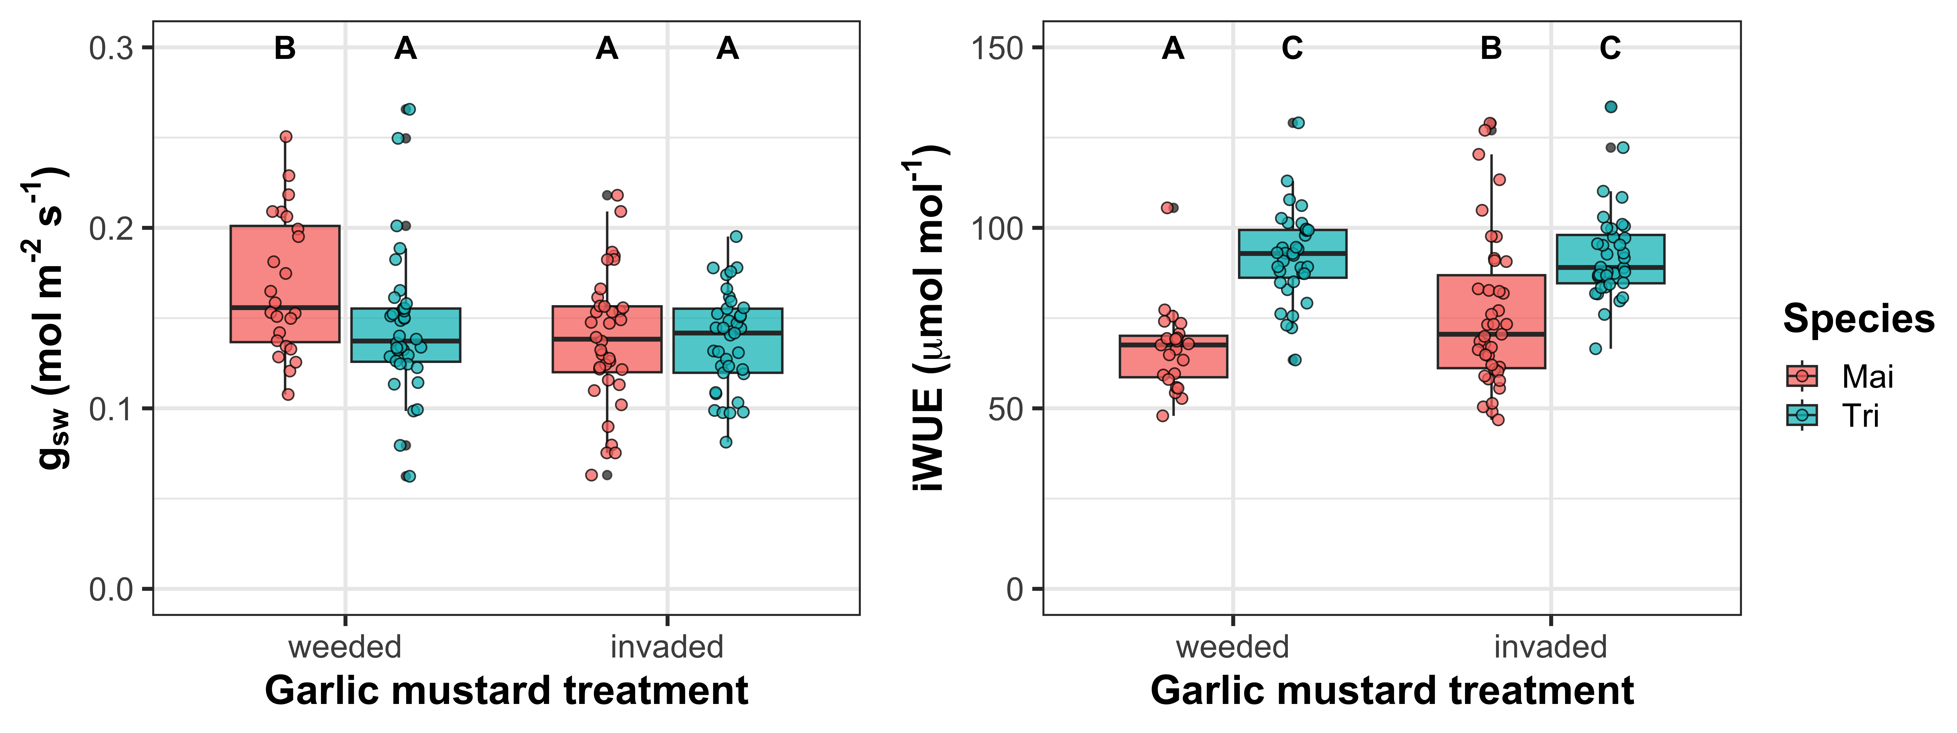
GM presence decreases stomatal conductance and increases intrinsic water use efficiency, but only in Maianthemum
R²_{m}=0.09; R²_{c}=0.14
R²_{m}=0.38; R²_{c}=0.50

Slide 6
GM presence decreases stomatal conductance and increases intrinsic water use efficiency, but only in Maianthemum
R²_{m}=0.09; R²_{c}=0.14
R²_{m}=0.38; R²_{c}=0.50

Slide 7
A few preliminary takeaways from categorical analyses
Maianthemum increases WUE with GM presence, though this does not influence photosynthetic capacity
Trillium physiology and water use seems unresponsive to GM invasion
GM treatments do not adequately explain garlic mustard densities
Plot 3 unweeded GM density >> Plot 7 unweeded GM density

Slide 8
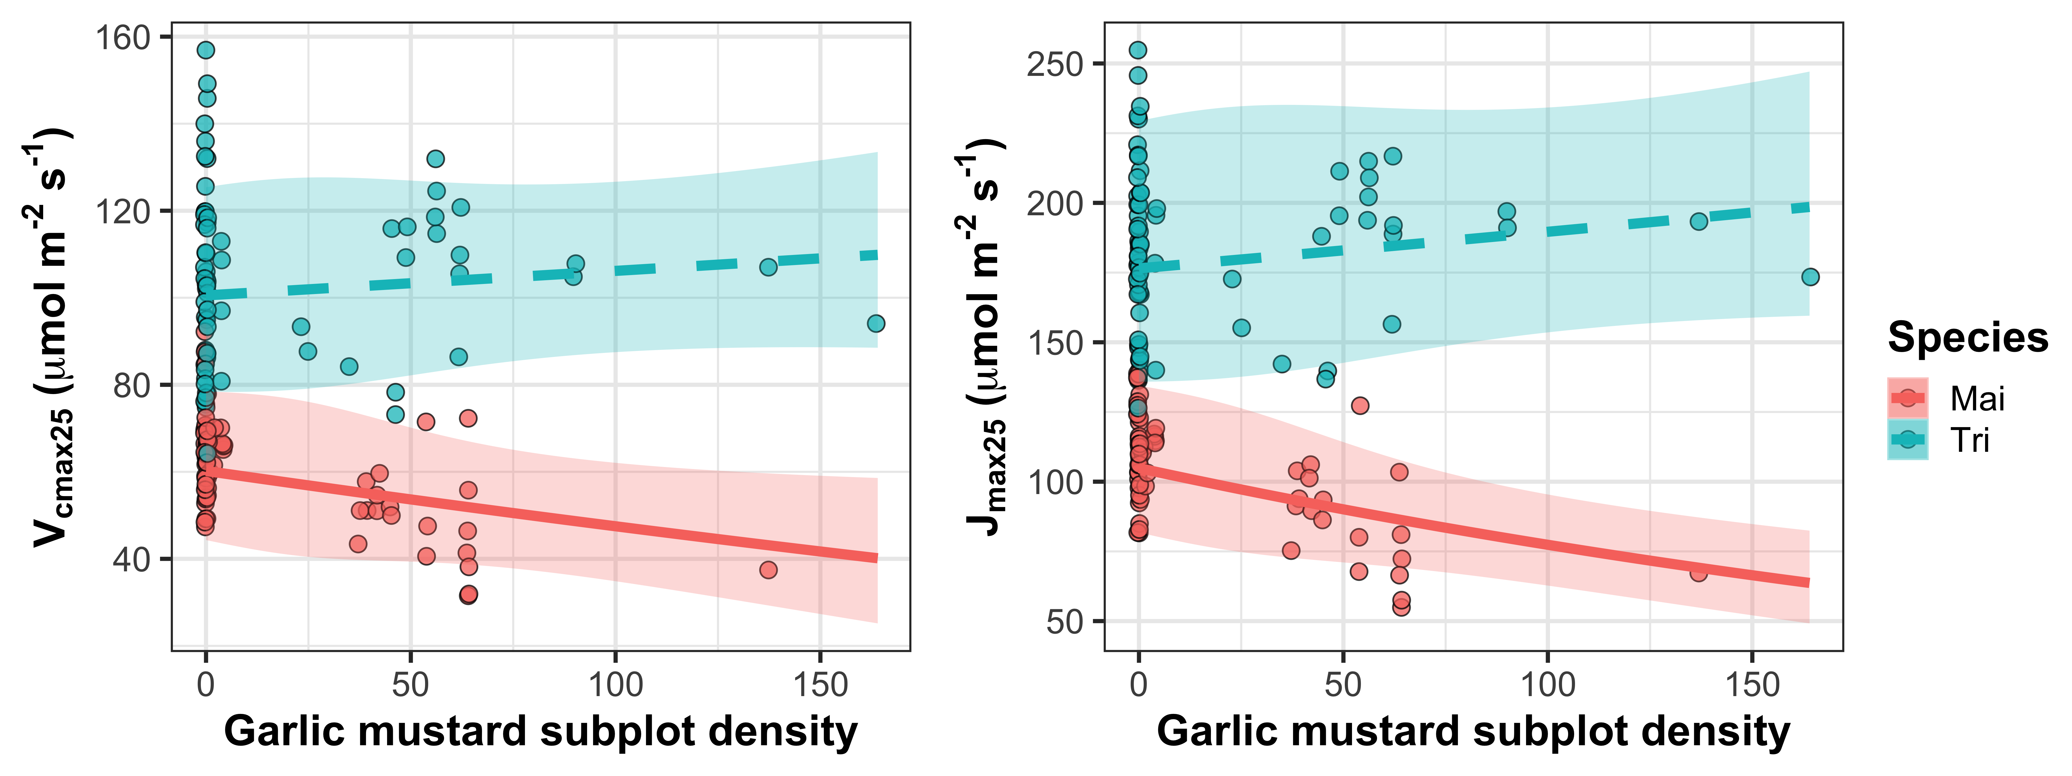
Increasing total GM density decreases photosynthetic capacity, but only in Maianthemum

Slide 9
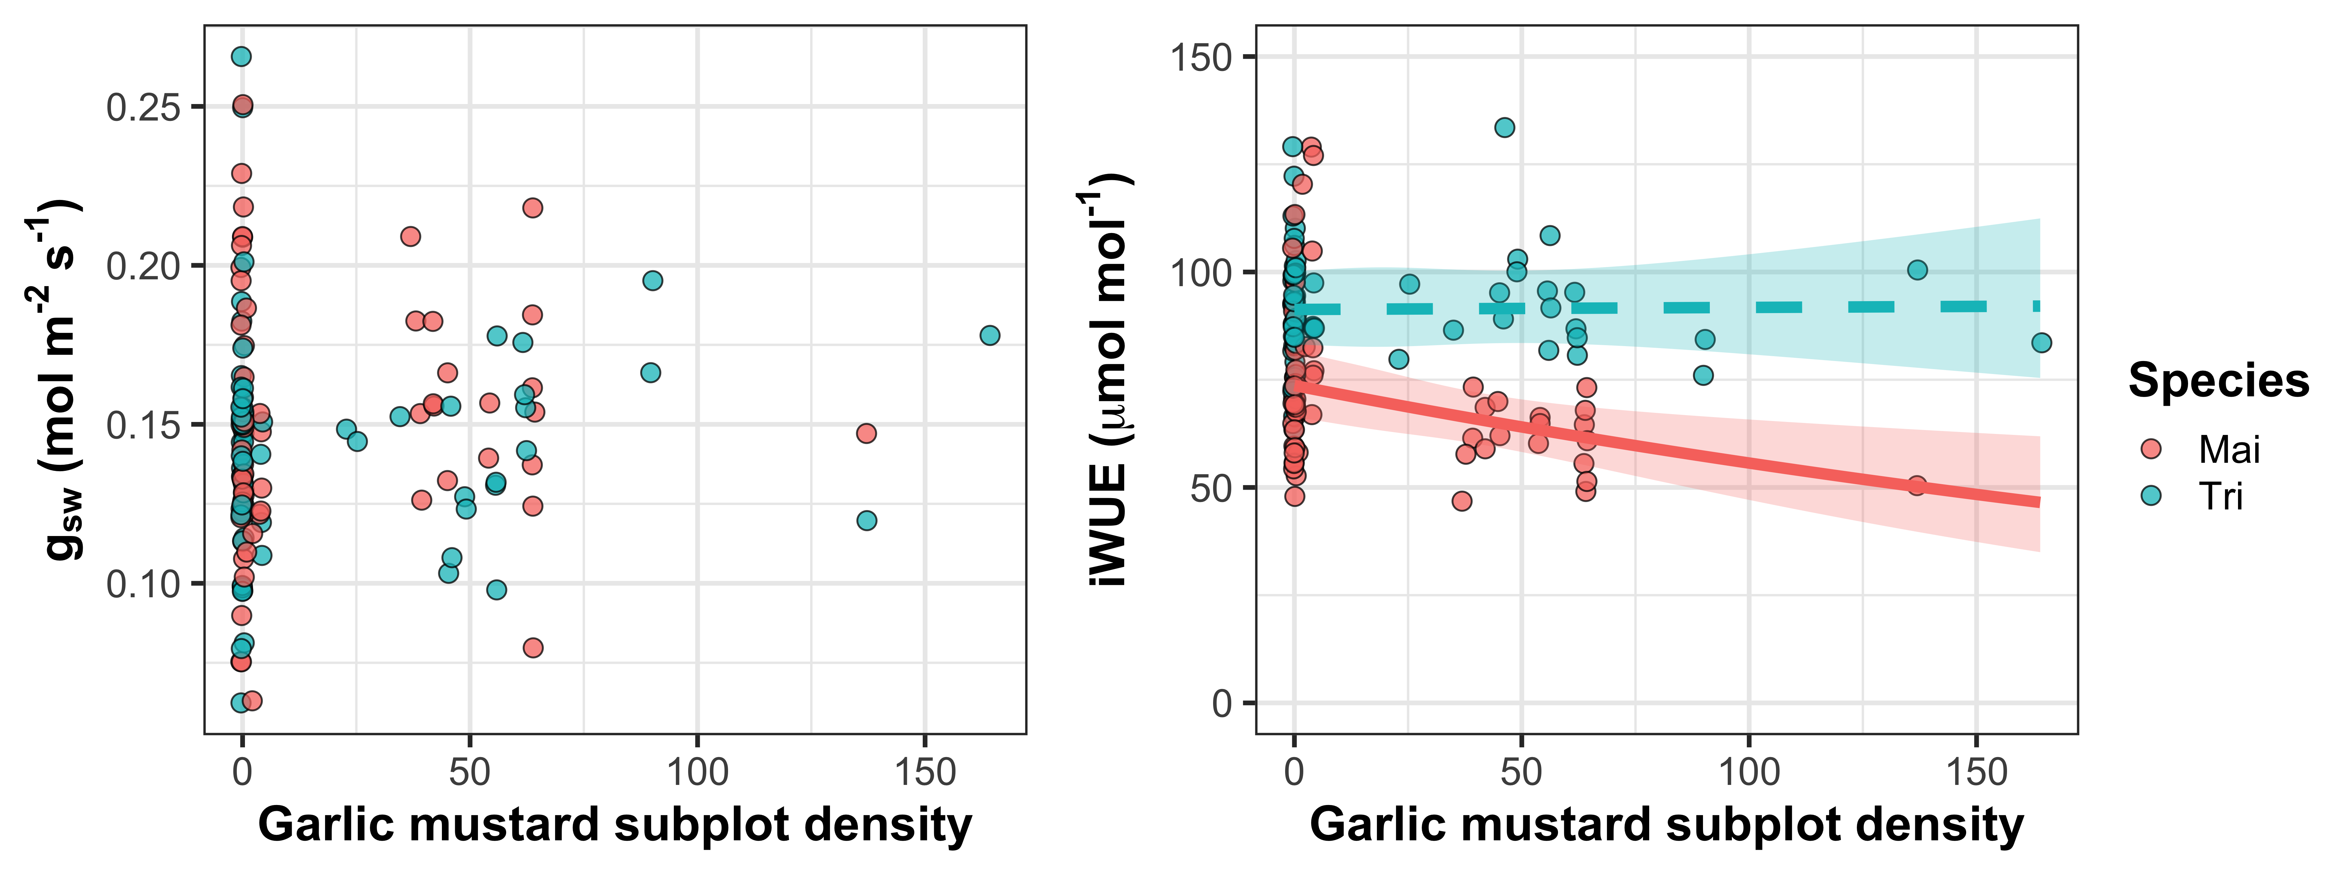
Increasing total GM density decreases water use efficiency, but only in Maianthemum

Slide 10
Preliminary conclusions
Garlic mustard density may better quantify effects of invasion on photosynthetic traits
Maianthemum seems more sensitive to garlic mustard invasion than Trillium.
Perhaps as a function of later emergence?
Maianthemum physiology responses are supportive of those expected from theory, though we may need more data points in subplots with high garlic mustard densities

Slide 11
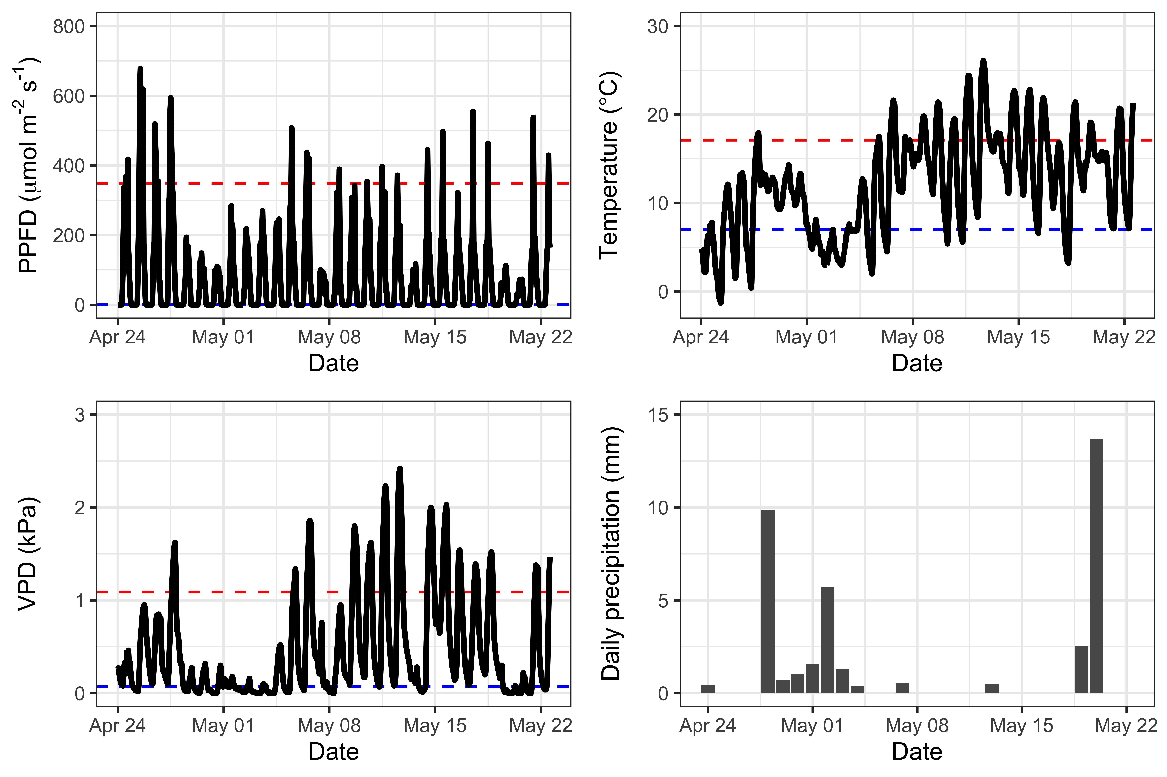
Recent weather trends (from weather station positioned between plots 4 and 5)

